Slide 1
Multimodal Stock Prediction Model
Clay Roberts, Pete Acevedo, Pedro Alvarado, Awaleh Houssein, Mateo Rivas

Slide 2
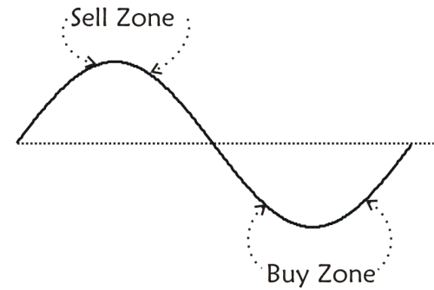
Introduction
The stock market is a system that offers participants the ability to buy and sell portions of ownership in an organization.
In return a participant’s investments increases or decreases depending on the organizations success.
Traders work to predict the market and optimize individual gains by buying and selling stock the moment before a stock swings positive or negative.
Stock prediction models work to identify complex relationships that influence the behavior of a stock, allowing a market participant to invest in anticipation of a desired outcome.

Slide 3

Research Problem
Stocks are affected by a plethora of factors including illogical human reaction and emotion. Some of which make things like predicting the behavior of stocks inherently difficult.
The research problem we aim to address is the accurate prediction of stock prices in spite of these factors, using a variety of machine learning methods.
Notes:
https://www.istockphoto.com/illustrations/stock-market

Slide 4
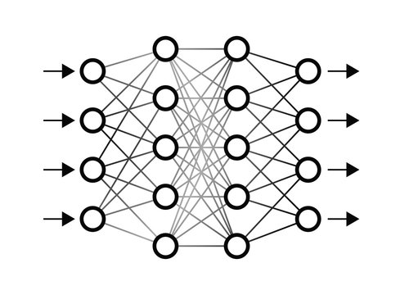
Methods
Long Short Term Memory (LSTM)
Recurrent Neural Network (RNN) that sequentially captures dependencies between data points.
Moving Average Time Series
Model that forecasts performance using historical data.
Self-Attention
A technique that eliminates the sequential nature of RNNs and allows for parallelization of relationship identification
Sentiment Analysis
Analyze input text based on context and return an overall sentiment.
If implemented, would be supplemental to the other methods’ analyses .
Notes:
https://stock.adobe.com/images/neural-network-illustration/179895957

Slide 5
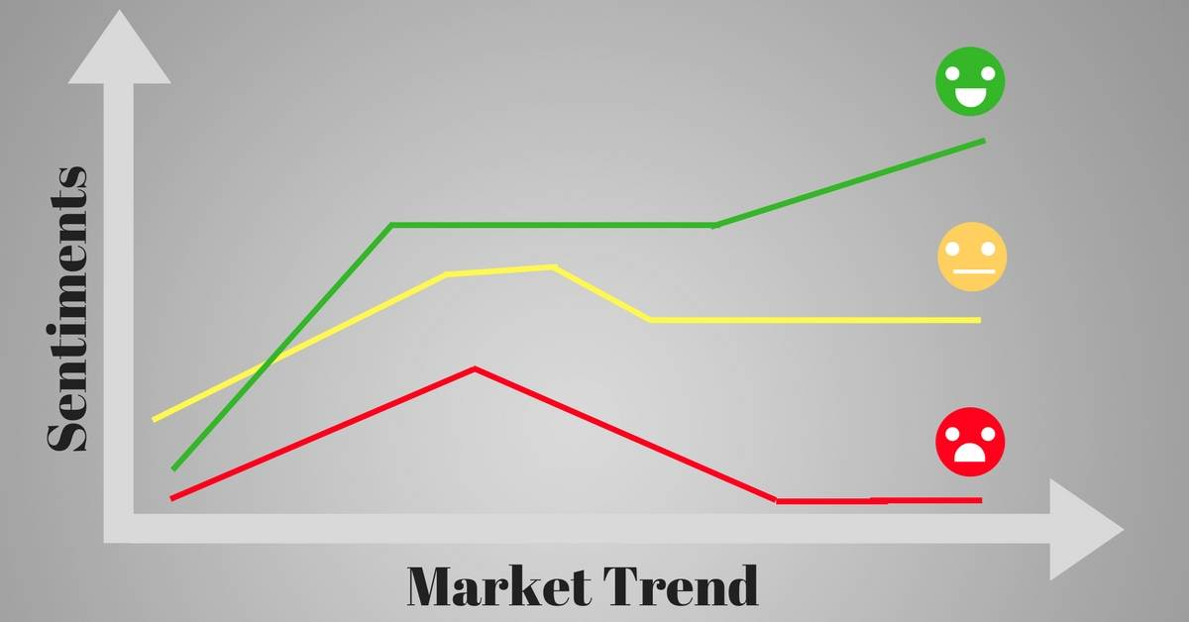
Novel Approach
The novel approach would aim to use sentiment analysis to predict if a press release for a company was announced with the intention of announcing positive news, or if that press release was instead announced to mitigate the impact of a future negative press release.
This proposal could result in valuable insight that adds an additional dimension for prediction.
Notes:
https://blog.quantinsti.com/crowdsourced-sentiment-analysis-strategy/

Slide 6
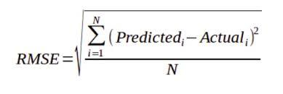
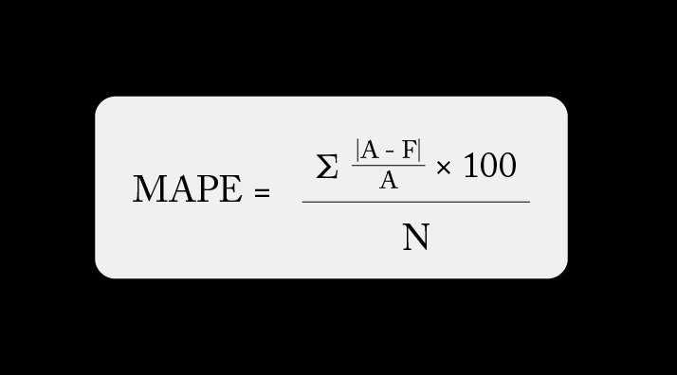
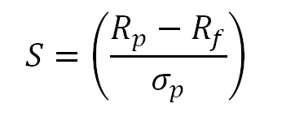
Experimental Setup
The model will be evaluated using a number of metrics, including:
Mean Absolute Percentage Error (MAPE)
Average difference between predicted and actual price
Root Mean Squared Error (RMSE)
Adds focus to outlier events
Sharpe Ratio
Compare return and associated risk on investment
Typical classification metrics
Accuracy, prediction, recall, F1
LSTM, Moving Average, and Self-Attention will be trained and tested on NVIDIA Corporation stock performance at close each day stretching back to 1999.
Sentiment analysis will require press releases to be scraped and then analyzed.
Notes:
https://www.geeksforgeeks.org/root-mean-square-error-in-r-programming/
https://arize.com/blog-course/mean-absolute-percentage-error-mape-what-you-need-to-know/
https://study.com/academy/lesson/how-to-calculate-sharpe-ratio-definition-formula-examples.html

Slide 7
Challenges Faced
Communication amongst the group has been limited.
The tight timelines make collaboration harder to organize.
Volatility of stock behaviors makes building an accurate model tougher.

Slide 8
Solutions
Communication can be improved through regular updates in the team’s correspondence platform.
Set dates for meetings in advance.
If everyone is not able to attend, take notes during meetings to keep the group informed.
Proper data cleaning, dimensionality reduction, and hyperparameter tuning can help minimize error from volatility.

Slide 9
Conclusion
The stock market is volatile, and this volatility makes it hard to predict the fate of a stock.
Stock market data is widely available to access.
Machine learning can be applied to this problem, and this data, using neural networks, time series decommission, and sentiment analysis to make more accurate predictions.

